Slide 1
CREDIT CARD FRAUD DETECTION
UE20CS302 – Machine Intelligence
Mini Project
Project Title : Credit Card Fraud Detection
Team No: 3
Project Guide : Dr. Arti Arya
Project Team with SRNs :
Raunak Singh, PES2UG20CS267
Rudraksh Sharma, PES2UG20CS287

Slide 2
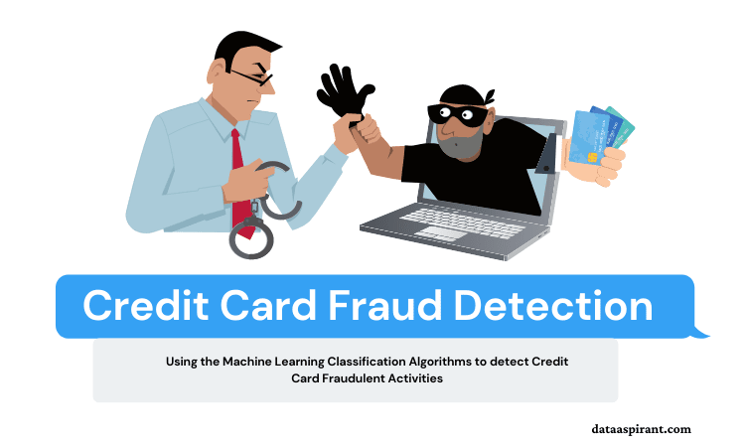
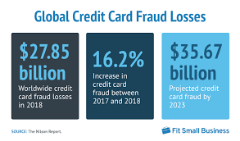
Problem Statement
The problem statement chosen for this project is to predict fraudulent card transactions with the help of machine learning model. In this project, we will analyze the customer-level data which has been collected. The dataset has been taken from the Kaggle website and it has a total of 2,84,807 transactions, out of which 492 are fraudulent. Since the dataset is highly imbalanced, it needs to be balanced before building the models.
Notes:
Provide a basic introduction of the project and also an overview of scope it entails.
Set the context.

Slide 3
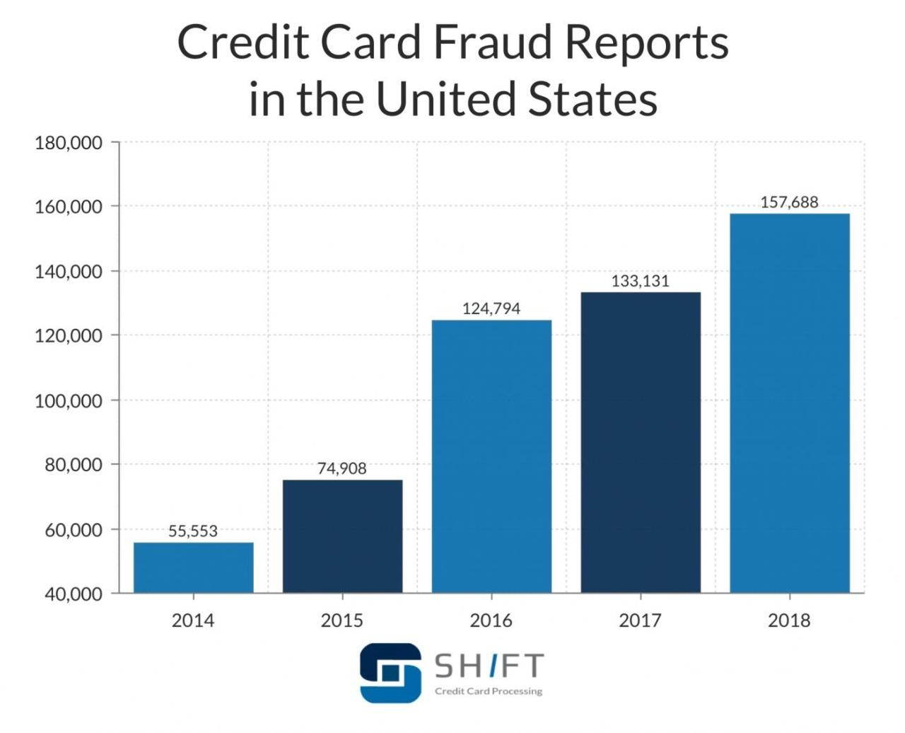
Application and Uses
The system can have application in banking firms and payment processing companies like
Razorpay, JusPay to detect fraudulent transactions.
Makes the transactions in E-commerce website more reliable.
The number of fraud cases which is increasing per year can be controlled
with the help of this method.
The users can feel much more secure in using credit cards for normal
uses also.
Notes:
Provide a basic introduction of the project and also an overview of scope it entails.
Set the context.

Slide 4
High level Architecture
Data acquisition
Data analysis
Balancing techniques
Training models
Highly
Imbalanced
No Null values
Under sampling
SMOTE
Decision trees
Logistic Regression
K-NN
Naïve bayes
Prediction
Finding accuracy
AdaBoost
XgBoost
Random Forest
Notes:
Provide a basic introduction of the project and also an overview of scope it entails.
Set the context.

Slide 5
Literature Survey
Title of the paper | Year of Publication | Journal/Conference Name | Advantages | Limitations
Analysis of Credit Card Fraud Detection using Machine Learning Techniques | 2022 | International Conference on Communication and Electronics Systems (ICCES) | Support Vector Machine, Deep Neural Network techniques, and Naive Bayes have been used. | Worked with imbalance dataset which gave them accuracy more than 98%.
Ensemble Learning based Credit Card Fraud Detection System | 2021 | Conference on Information and Communication Technology (CICT) | Under-sampling was used for balancing the dataset. Ensemble learning resulted in good accuracy. | The model could have been trained with soft voting technique also.
Fraud Detection in Credit Cards Based on Transaction Dynamics in Subspaces | 2019 | International Conference on Computational Science and Computational Intelligence (CSCI) | It’s a new approach. Uses dynamic features in low dimensional subspaces and then fused for result. Improves detection performance. | This is a very Complex Approach And uses only AUC as performance metric.
Notes:
Provide summary of Phase – 1.
Include the suggestions and improvements made.

Slide 6
Literature Survey
Title of the paper | Year of Publication | Journal/Conference Name | Advantages | Limitations
Credit card fraud detection using machine learning algorithms | 2018 | IEEE Internet of Things journal | Multiple supervised techniques are used | Strong class imbalance, ability to process a number of transactions
A comparative analysis of various credit card fraud detection techniques | 2019 | International Journal of Research, Technology and Engineering (IJRTE) | Models are added until either the entire dataset is predicted correctly or maximum number is reached | Low accuracy across all models
Machine learning for credit card fraud detection | 2018 | International Journal of Research, Technology and Engineering (IJRTE) | Extensive review is done | Need to detect fraud even before it takes place
Notes:
Provide summary of Phase – 1.
Include the suggestions and improvements made.

Slide 7
Proposed Approach
Data acquired, reading of dataset followed by data analysis i.e checking if there is any null value present ,if yes then remove them and checking if the data is balanced or not.
Two sampling techniques(under-sampling & SMOTE) for balancing the dataset have been used.
The data is split into training and testing set with 80% as training data and 20% as testing data.
ML models are then trained and tested on the test dataset .
The accuracy is calculated for every trained model and then prediction is done.
Notes:
Provide summary of Phase – 1.
Include the suggestions and improvements made.

Slide 8
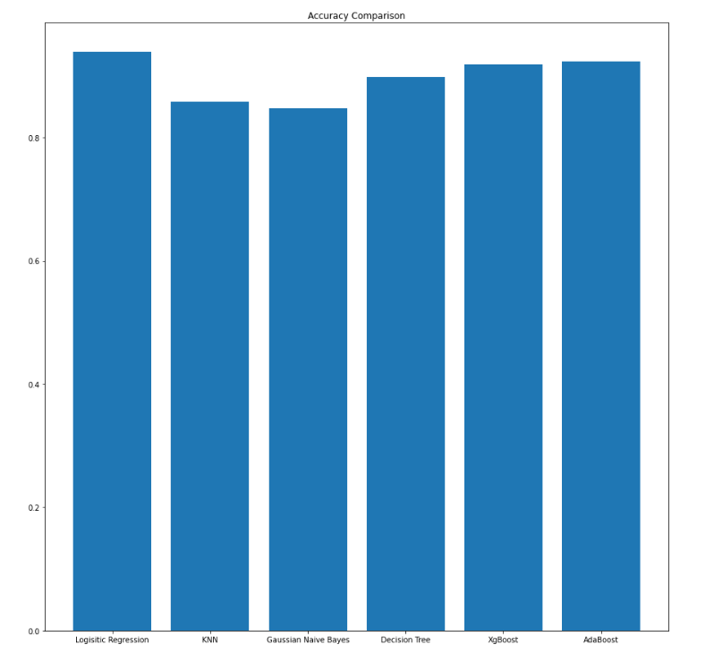
Results and Discussion
UNDER-SAMPLING TECHNIQUE
MODEL | ACCURACY (IN %)
LOGISTIC REGRESSION | 93%
K-NEAREST NEIGHBOUR | 86%
GAUSSIAN NAÏVE BAYES | 85%
DECISION TREE | 90%
XGBOOST | 92%
ADABOOST | 92%
Notes:
Provide summary of Phase – 1.
Include the suggestions and improvements made.

Slide 9
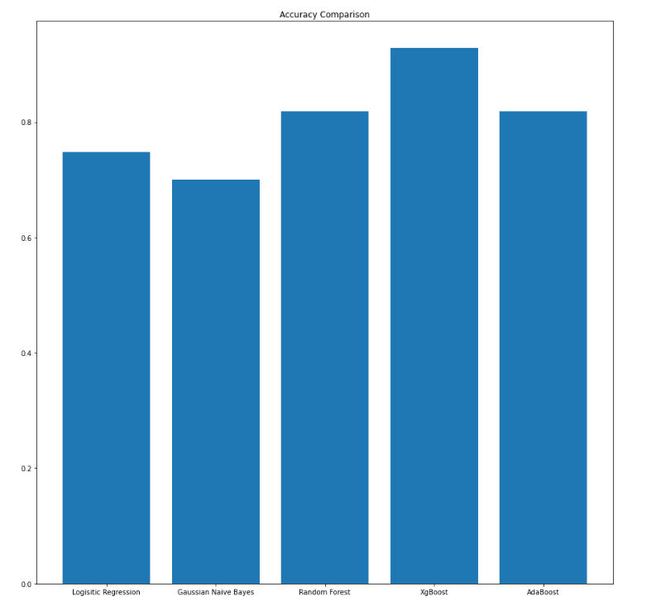
Results and Discussion
SMOTE TECHNIQUE
MODEL | ACCURACY (IN %)
LOGISTIC REGRESSION | 75%
RANDOM FOREST | 82%
GAUSSIAN NAÏVE BAYES | 71%
ADABOOST | 82%
XGBOOST | 93%
Notes:
Provide summary of Phase – 1.
Include the suggestions and improvements made.

Slide 10
LIMITATIONS
Using Under-sampling technique in a dataset causes high loss of information which could be
Important for a model to learn.
SMOTE technique increases the number of observations in the dataset to a great extent which is
not suitable for many model for learning.
This project only focused on Accuracy as a performance parameter.
Notes:
Provide summary of Phase – 1.
Include the suggestions and improvements made.

Slide 11
References
M. Mohandes, M. Deriche and S. Aliyu, “Classifiers Combination Techniques: A Comprehensive Review”, IEEE Access, vol. 6, pp. 19626-19639, 2018
S. Makki, Z. Assaghir, Y. Taher, R. Haque, M. Hacid and H. Zeineddine, An experimental study with imbalance classification approaches for credit card fraud detection
I. Sohony, R. Pratap and U. Nambiar, “Ensemble learning for credit card fraud detection”, Proceedings of the ACM India Joint International Conference on Data Science and Management of Data Association for computing machinery, 2018
S.B.E. Raj and A.A Portia, “Analysis on credit card fraud detection methods”, IEEE International Conference on Computer Communication and Electrical Technology - ICCCET 2011, pp. 152-156, 2011
Notes:
Provide summary of Phase – 1.
Include the suggestions and improvements made.

Slide 12
Thank You

